Slide 1
A PROJECT on “SIGN LANGUAGE DETECTION USING DEEP LEARNING”
ODISHA UNIVERSITY
OF
TECHNOLOGY & RESEARCH ,BBSR
Presented By :-
Sridhar Prasad Dash 1801106536
Srijeeth Panda 1801106537
Debasish Behera 1921106026
Guided By :-
Mrs. Subhalaxmi Das
Dept. of Computer Science and Engineering,
OUTR-B

Slide 2
CONTENTS
Introduction
Motivation & Objective
Methodology & Working Principle
Bounding box detection
Image segmention
Key point detection
Final model for sign language detection
Performance of the model
Snaps of Real time sign language detection
Future Enhancement
Conclusion
References

Slide 3
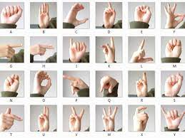
INTRODUCTION
Communication is very crucial to human beings, as it enables us to express ourselves. We communicate through speech, gestures, body language, reading, writing or through visual aids, speech being one of the most commonly used among them. However, unfortunately, for the speaking and hearing impaired minority, there is a communication gap. Visual aids, or an interpreter, are used for communicating with them. However, these methods are rather cumbersome and expensive, and can't be used in an emergency. Sign Language chiefly uses manual communication to convey meaning. This involves simultaneously combining hand shapes, orientations and movement of the hands, arms or body to express the speaker's thoughts.
Sign Language consists of fingerspelling, which spells out words character by character, and word level association which involves hand gestures that convey the word meaning. Fingerspelling is a vital tool in sign language, as it enables the communication of names, addresses and other words that do not carry a meaning in word level association. In spite of this, fingerspelling is not widely used as it is challenging to understand and difficult to use. Moreover, there is no universal sign language and very few people know it, which makes it an inadequate alternative for communication.
fig:1 sign language

Slide 4
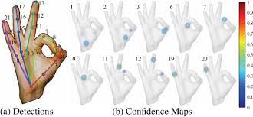
Motivation & OBJECTIVE
The current state of the art object detection algorithms are highly time consuming in case of object detection and training specially.
Adding on to it these algorithms needs loads and loads of images for training ,
which bounds the usages of high end computers.
Our objective is to cascade the highly efficient algorithms to make a deep neural network which can predict the sign language with high accuracy and low latency.
Our main motivation is to make a model which is compatible to real world situation.
these objectives boils down to have a model which can predict hand gesture and key points of hand gesture.

Slide 5
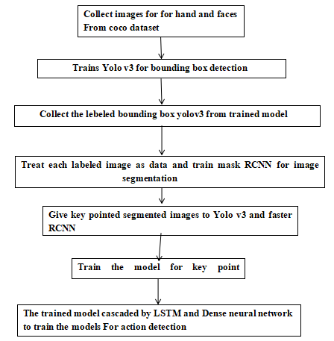
Methodology & Working Principle

Slide 6
Contd...
Used Neural networks:-
YOLO v3 for bounding Box detection (only first 32 layers)
Faster mask R-CNN for segmentaion of image (only first 16 layers)
Convex plane key point detection for key point detection
LSTM and deep ANN for action detection
Used Important Modules:-
Tensorflow
Keras
Numpy
Coco API and Pycocotools
Media pipeline
Open CV

Slide 7
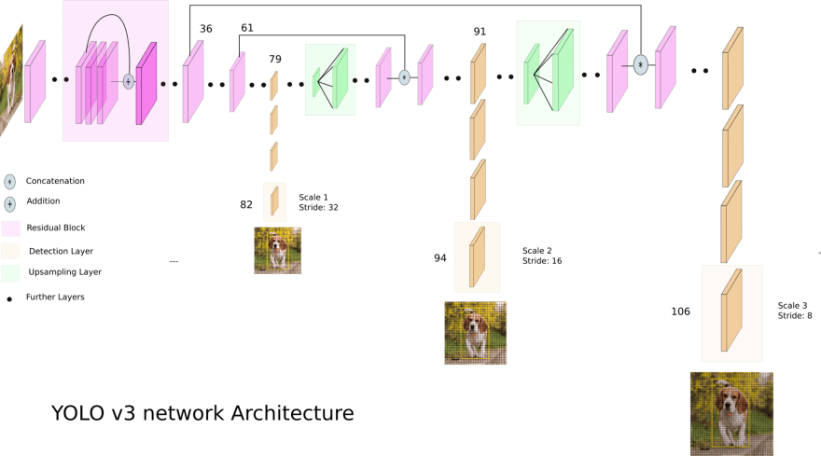
Bounding box detection
Algorithms used:
YOLO v3
fig:2 Yolo v3 Architecture

Slide 8
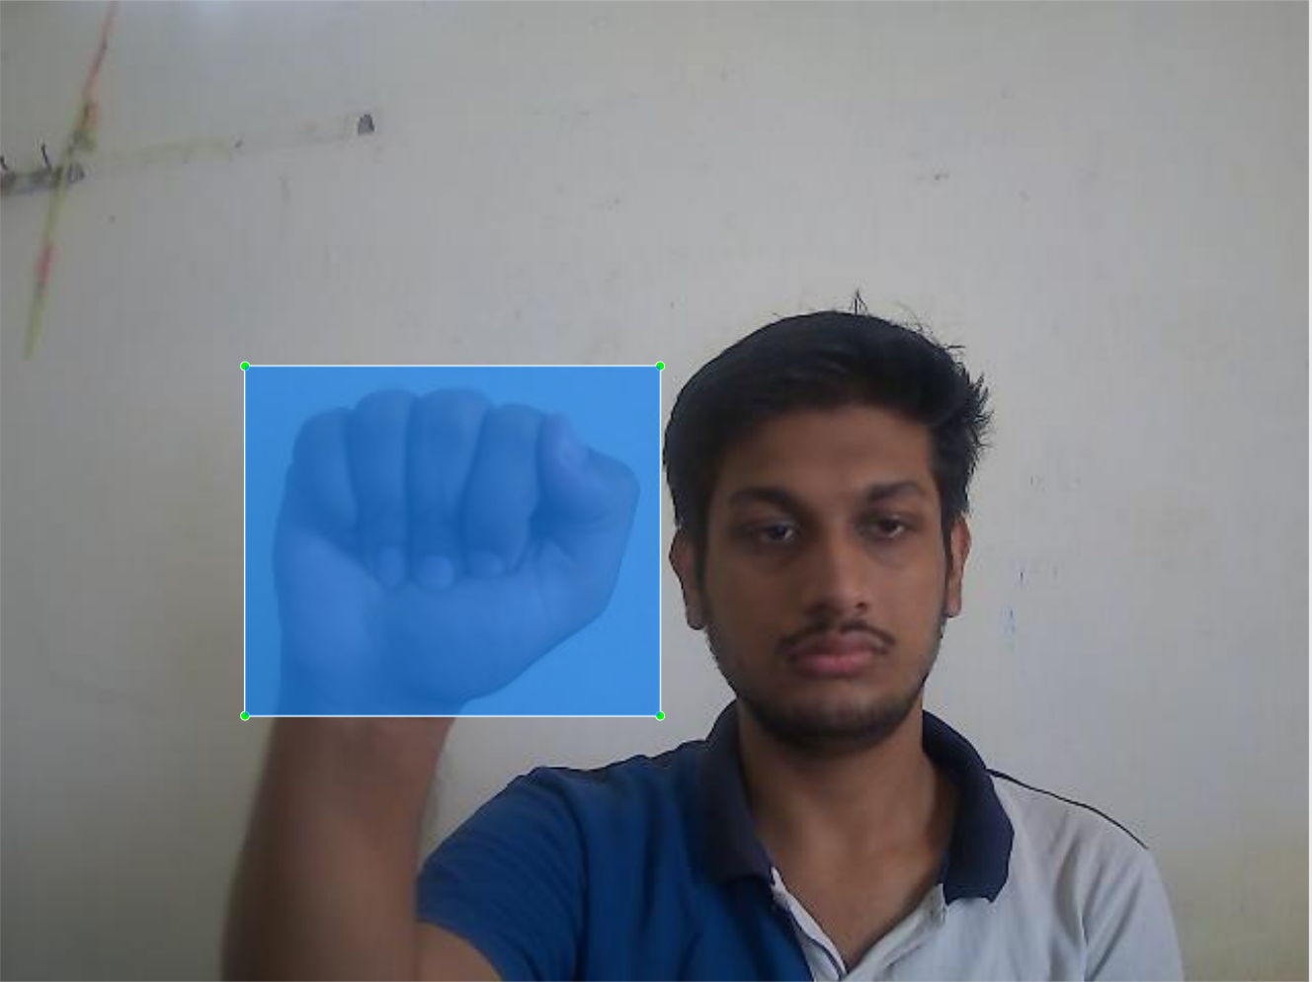
INPUT AND output of Yolo v3 :
INPUT:
Input of the Yolo v3 is annoted images means every image has a .xml file in the format of
<object>
<name>Hand</name>
<pose>Unspecified</pose>
<truncated>0</truncated>
<difficult>0</difficult>
<bndbox>
<xmin>129</xmin>
<ymin>179</ymin>
<xmax>322</xmax>
<ymax>360</ymax>
</bndbox>
</object>
OUTPUT:
fig:3 Bounding box detection

Slide 9
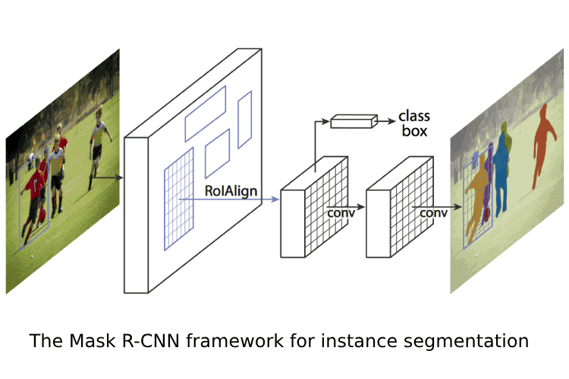
IMage segmentation
Algorithm used:
Faster mask R-CNN
fig:4 Faster mask R-CNN Architecture
As first RolAlign and consequent CNN is responsible for image segmentation so we took those tho neural with depth 16 layers.
Here not we have done instance segmentation, so that model can handle multiple hand gestures and complex gestures

Slide 10
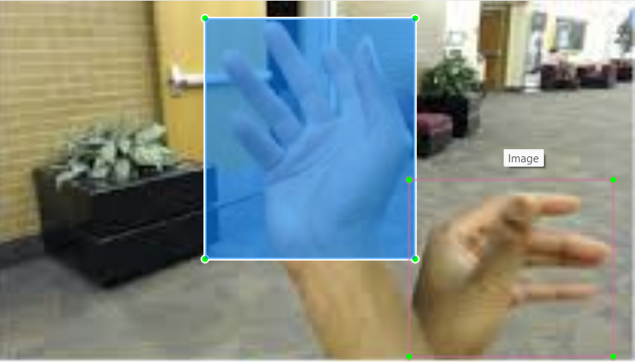
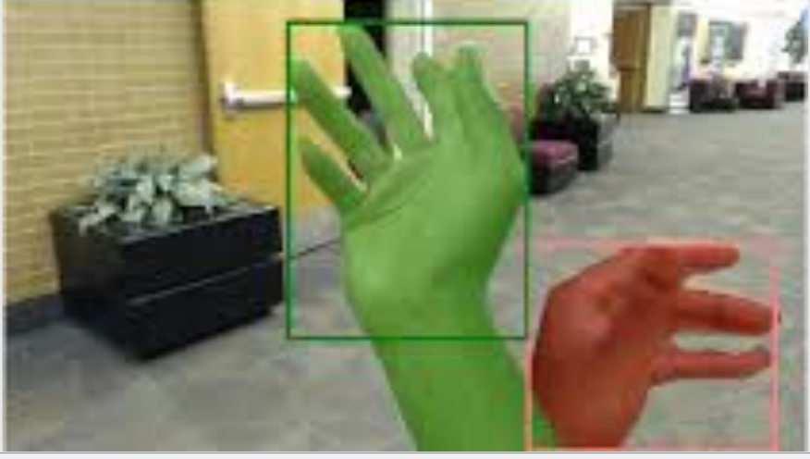
INPUT AND OUTPUT OF mask R-CNN :
INPUT:
<object>
<name>Hand 1</name>
<pose>Unspecified</pose>
<truncated>0</truncated>
<difficult>0</difficult>
<bndbox>
<xmin>68</xmin>
<ymin>5</ymin>
<xmax>137</xmax>
<ymax>84</ymax>
</bndbox>
</object>
<object>
<name>Hand 2</name>
<pose>Unspecified</pose>
<truncated>0</truncated>
<difficult>0</difficult>
<bndbox>
<xmin>135</xmin>
<ymin>58</ymin>
<xmax>202</xmax>
<ymax>116</ymax>
</bndbox>
</object>
fig:5 Input for img segmentation
OUTPUT:
fig:6 Output of img segmentation

Slide 11

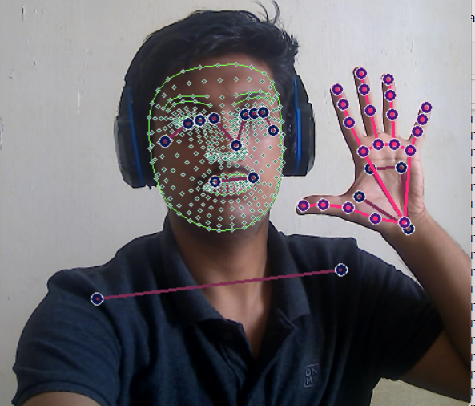
KEY POINT DETECTION
Algorithms used:
Convex plane key point detection
In this Algorithm each segmented instances are treated as a convex plane.
key point are determined by taking middle point of two side edges which are consequent to each other.
we are taking 21 key point from each hand and 1440 key points in from the pose and face.
INPUT : OUTPUT:
fig:7 Input of key point detection fig:8 Output of key point detection

Slide 12
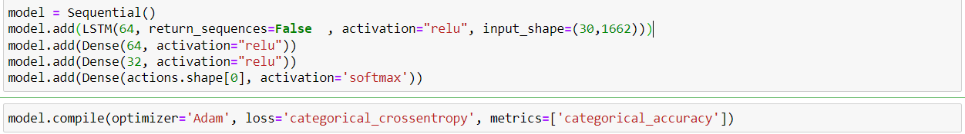
DATA collection for ACTION detection
We have taken 5 different signs : “Hello” , “Good” , “Stop”, “Thanks”, “Please”.
For each image we took 100 images .
For action detection we consider 30 frames and each frame has 1662 key point numpy array.
We stack 30 , (1662,1) sized numpy array to create a single training row .
We split the data set into 8:2 for training and testing purpose.
Final training Neural network Model
Total parameters : 448,517
Activation Function used : ReLU
Classifier : Softmax
Optimizer used: Adam

Slide 13
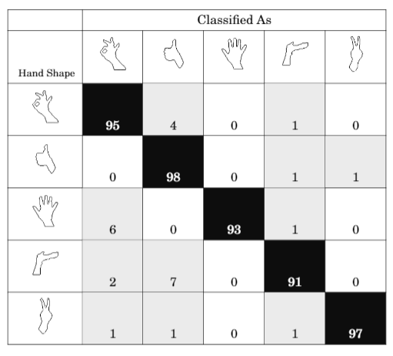
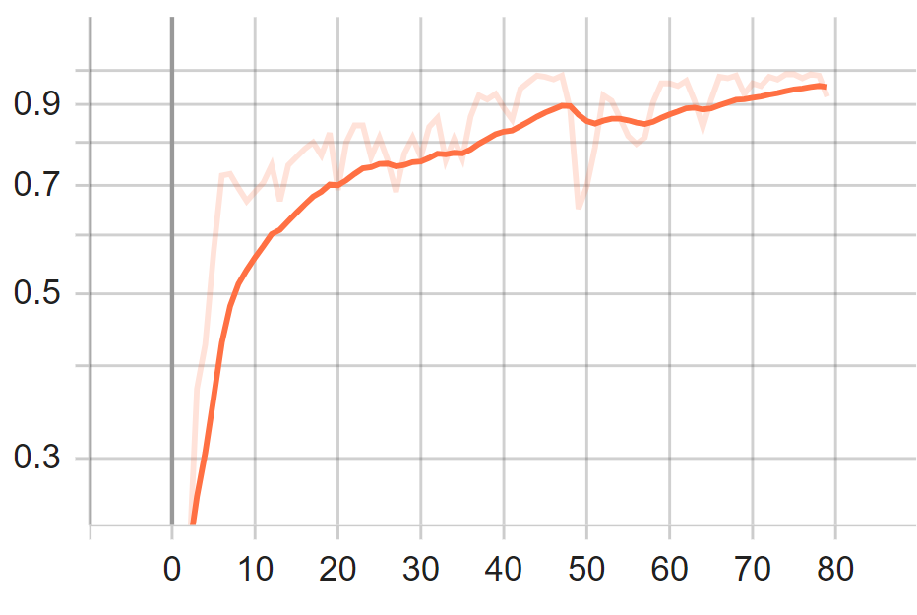
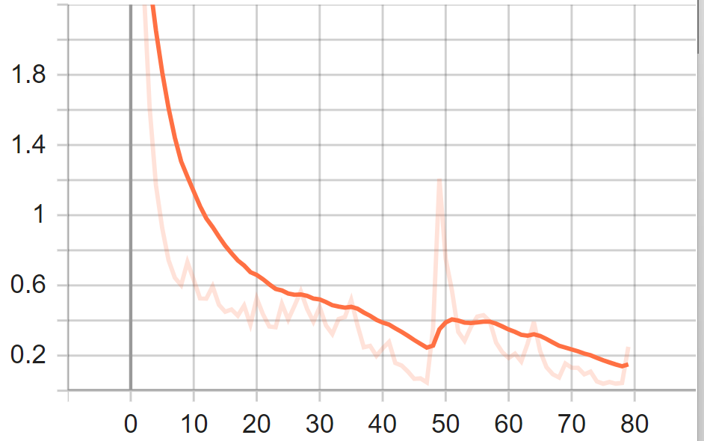
performance of model
fig:9 confusion matrix fig:10 training accuracy vs epoch fig:11 loss vs epoch
Epochs : 80
Training Time : 1 min approx.
Training Accuracy: 0.92
Testing Accuracy: 0.95
Precision: 0.98
Recall: 0.96
fig no:6: Deployment of the model

Slide 14
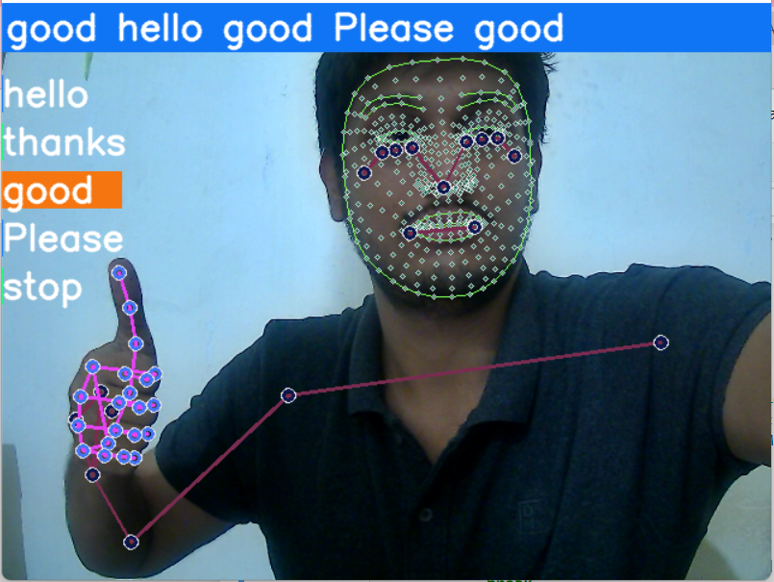
Snaps of sign language detection
fig:12 Real time sign detection

Slide 15
FUTURE ENHANCEMENT
This project can be extended to real time low latency sign language detection with more than 300 signs and can be trained under 1 hr to 2hr approximatly.
We can add delimiters and other punctuation for forming proper sentences using words detected by model.
As we are using key points for faces also this model can be trained for emotion detection also.combining emotion detection and sign language detection will give more sense to the model

Slide 16
CONCLUSION
In this project , a practical ongoing vision based american communication through signing acknowledgment for D&M individuals have been created for asl words.We accomplished last exactness of 95.0% on our dataset. We can work on our expectation subsequent to executing two layers of calculations in which we confirm and anticipate images which are more like one another. This way we can identify practically every one of the images given that they are shown appropriately, there is no clamor behind the scenes and lighting is sufficient.
We are wanting to accomplish higher precision ,and low latency even if there should arise an occurrence of complex foundations by evaluating different foundation deduction calculations. We are additionally considering working on the preprocessing to anticipate signals in low light circumstances with a higher precision.

Slide 17
REFERENCES
Wang H, Chai X, Zhou Y, Chen X. Fast sign language recognition benefited from low rank approximation. 2015 11th IEEE International Conference and Workshops on Automatic Face and Gesture Recognition, FG 2015. 2015.
Singha J, Das K. Indian Sign Language Recognition Using Eigen Value Weighted Euclidean Distance Based Classification Technique. arXiv preprint arXiv:1303.0634. 2013; 4(2): p. 188-195.
Kalsh EA, Garewal NS. Sign Language Recognition System. International Journal of Computational Engineering Research. 2013; 03(6): p. 15-21
Tewari D, Srivastava S. A Visual Recognition of Static Hand Gestures in Indian Sign Language based on Kohonen Self-Organizing MapAlgorithm. International Journal of Engineering and Advanced Technology (IJEAT). 2012; 2(2): p. 165-170.
Raheja JL, Mishra A, Chaudary A. Indian Sign Language Recognition Using SVM 1. Pattern Recognition and Image Analysis. 2016 September; 26(2).
Kishore PVV, Prasad MVD, Prasad CR, Rahul R. 4-Camera model for sign language recognition using elliptical fourier descriptors and ANN. In International Conference on Signal Processing and Communication Engineering Systems - Proceedings of SPACES 2015, in Association with IEEE; 2015. p. 34-38.
Goyal,Sakshi & Sharma,Ishita & Sharma, Shanu. Sign Language Recognition System For Deaf And Dumb People. International Journal of Engineering Research & Technology (IJERT). 2013 April; 2(4).
Huang J, Zhou W, Li H, Li W. Sign language recognition using 3D convolutional neural networks. In Multimedia and Expo (ICME), 2015 IEEE International Conference on; 2015: IEEE. p. 1-6.
Chai X, Li G, Lin Y, Xu Z, Tang Y, Chen X. Sign Language Recognition and Translation with Kinect. The 10th IEEE International Conference on Automatic Face and Gesture Recognition. 2013;: p. 22-26. 12. Pigou L, Dieleman S, Kindermans PJ, Schrauwen B. Sign Language Recognition using Convolutional Neural Networks. In Workshop at the European Conference on Computer Vision; 2014; Belgium. p. 572-578.
Greg C. Lee & Fu-Hao Yeh & Yi-Han Hsiao. Kinect-based Taiwanese sign-language recognition system. Multimed Tools Appl. 2014 October.
Zhang LG, Chen Y, Fang G, Chen X, Gao W. A Vision-Based Sign Language Recognition System. In Proceedings of the 6th International Conference on Multimodal Interfaces; 2004; Pennyslavia: ACM. p. 198-204

Slide 18
THANK YOU

